Slide 1
IPL ANALYSIS
PRESENT BY
NANTHINI V

Slide 2
Introduction
The Indian Premier League (IPL) Is One Of The Most Competitive T20 Cricket Leagues Globally, Started In 2008. Over 18 Seasons, IPL Has Evolved In Terms Of Team Strategies, Player Performances, Scoring Patterns, And Competition Intensity.
This Project Analyzes Ipl Data From 2008 To 2025 To Identify Trends In Team Performance, Batting Dominance, Bowling Impact, And Seasonal Comparisons Using An Interactive Power Bi Dashboard.

Slide 3
Problem Statement
IPL Generates Massive Ball-by-ball And Match-level Data Every Season. However:
It Is Difficult To Track Long-term Team Performance.
Comparing Players Across Seasons Is Complex.
Identifying Consistent Orange Cap And Purple Cap Winners Requires Analysis.
Raw Data Does Not Provide Meaningful Insights Without Visualization.

Slide 4
Business Problem
From A Sports Analytics Perspective:
Team Management Needs Performance Insights.
Analysts Require Season-wise Comparison.
Broadcasters Need Statistical Highlights.
Fans Want Historical Performance Analysis

Slide 5
Data Overview
Matches Table – Around 1000+ rows and 18–20 columns
Ball-by-Ball Table – Around 200,000+ rows and 15–20 columns
Players Table – Around 600 rows and 5–8 columns
Teams Table – Around 10 rows and 2–4 columns
Match-level Data:
Match ID
Team
Season(2008-2025)
Winner
Toss Result
Player_data_updated
Player Id
Player Name
Bat
Blow
Player Full Name
Team Information
Team Name
Logo
Short Name
Ball-by-ball Data
Batter
Bowler
Runs
Wickets
Overs
Boundaries (4s & 6s)

Slide 6
Data Preprocessing
Removed Duplicate Match Records
Standardized Team Names
Converted Date Fields
Created Calculated Columns:Year
Added URL in dataset

Slide 7
Key Metrics & KPI’s
Tournament KPI’s
Total 6’s – 1296
Total 4’s – 2251
Total Matches – 73
Total Teams – 10
Centuries – 9
Half Centuries – 143
Total Venues – 14

Slide 8
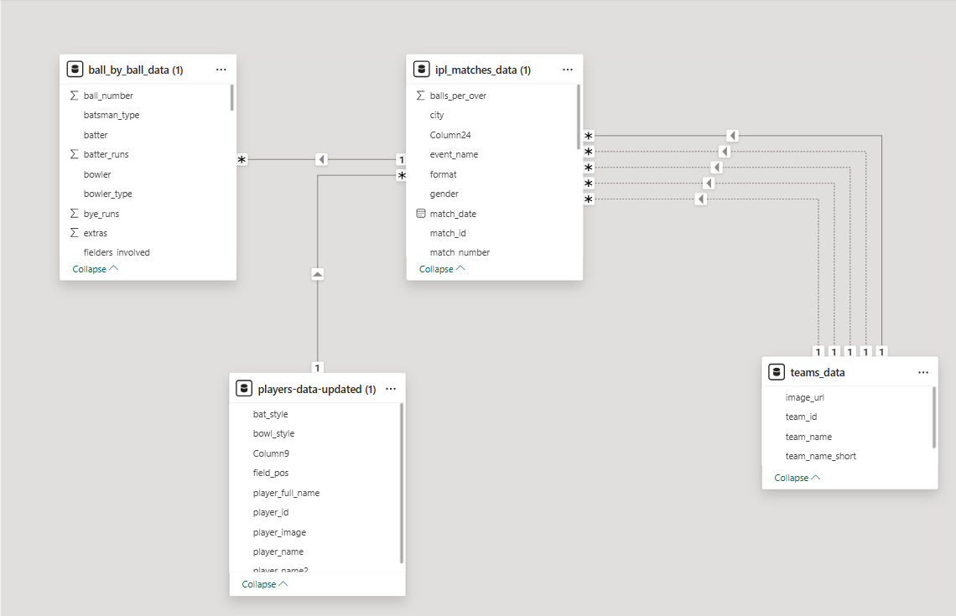
Data modelling -overview
Established Relationships
using a star schema

Slide 9
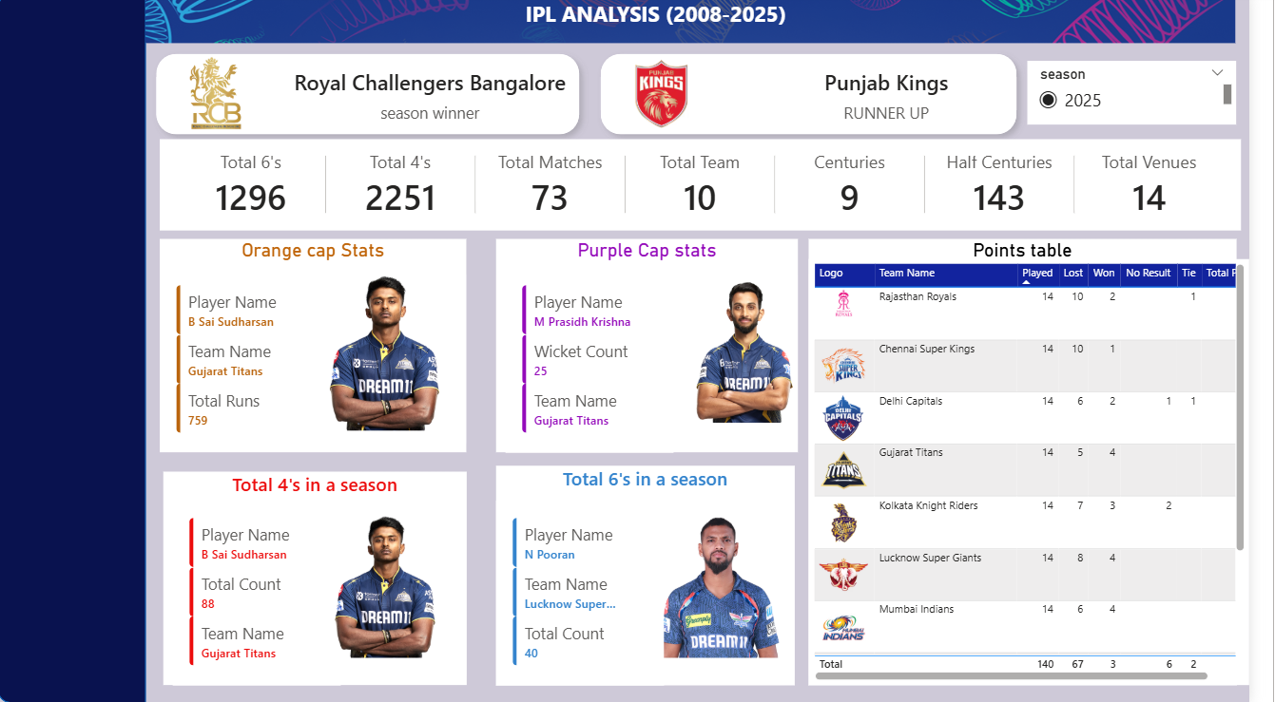
Power bi dashboard

Slide 10
Season Information :
At the top of the dashboard we display:
Season Winner
Runner-Up

Slide 11
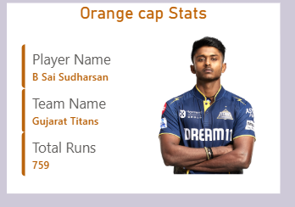
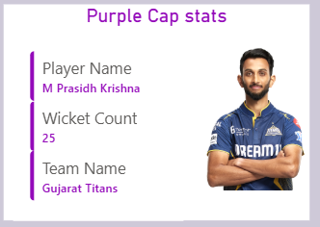
Orange Cap Statistics :
Orange Cap Is Awarded To The Player Who Scores The Most Runs In A Season.
Example From Your Dashboard:
Player: B Sai Sudharsan Team: Gujarat Titans Runs: 759
Purple Cap Statistics :
Purple Cap Is Awarded To The Player Who Takes The Most Wickets In A Season.
Example:
Player: M Prasidh Krishna Wickets: 25 Team: Gujarat Titans

Slide 12
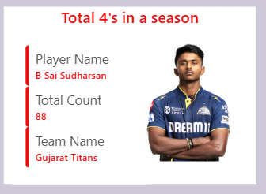
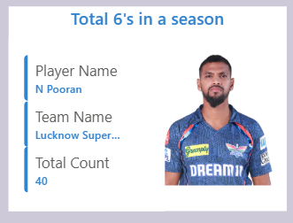
Boundary Performance :
Total 4’s In A Season
Player With Most 4’s
Total Boundary Count
Total 6’s In A Season
Player With Most 6’s
Total Sixes

Slide 13
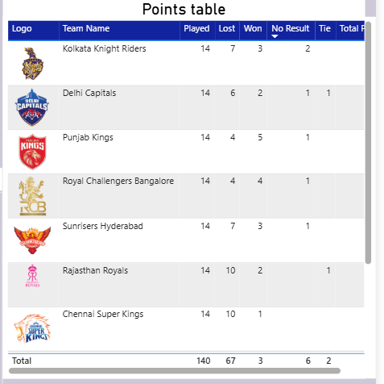
THE POINTS TABLE HELPS ANALYZE:
Team Performance During The League Stage
Team Ranking
Qualification Chances For Playoffs

Slide 14
Conclusion
This Dashboard:
Converts Raw IPL Data Into Meaningful Insights
Helps Compare Seasons Easily
Identifies Top-performing Players
Supports Sports Analytics Decision-making

Slide 15
Thank you

